Slide 1
Some Discrete Probability Distributions

Slide 2
Binomial Distribution

Slide 3
Binomial Distribution
An experiment often consists of repeated trials, each with two possible outcomes that may be labeled success or failure.
The process is referred to as a Bernoulli process. Each trial is called a Bernoulli trial.
Strictly speaking, the Bernoulli process must possess the following properties:
The experiment consists of repeated trials.
Each trial results in an outcome that may be classified as a success or a failure.
The probability of success, denoted by p, remains constant from trial to trial.
The repeated trials are independent.

Slide 4
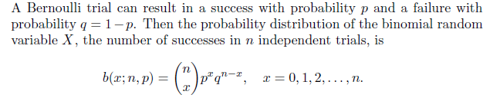


Binomial Distribution
The number X of successes in n Bernoulli trials is called a binomial random variable. The probability distribution of this discrete random variable is called the binomial distribution, and its values will be denoted by b(x; n, p)

Slide 5

when n = 3 and p = 1/4, the probability distribution of X, the number of defectives, may be written as

Slide 6

Example: The probability that a certain kind of component will survive a shock test is 3/4. Find the probability that exactly 2 of the next 4 components tested survive.
Solution:

Slide 7
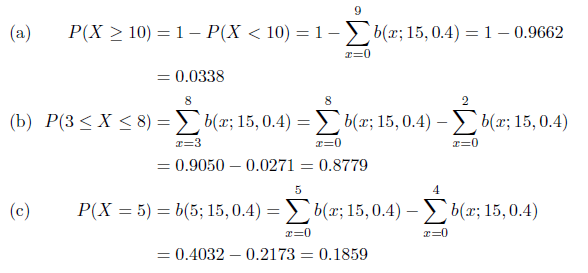
Example: The probability that a patient recovers from a rare blood disease is 0.4. If 15 people are known to have contracted this disease, what is the probability that (a) at least 10 survive, (b) from 3 to 8 survive, and (c) exactly 5 survive?
Solution:

Slide 8

Example: A large chain retailer purchases a certain kind of electronic device from a manufacturer. The manufacturer indicates that the defective rate of the device is 3%.
The inspector randomly picks 20 devices from a shipment. What is the probability that there will be at least one defective item among these 20?

Slide 9
Areas of Application
The binomial distribution finds applications in many scientific fields. An industrial engineer is keenly interested in the “proportion defective” in an industrial process. Often, quality control measures and sampling schemes for processes are based on the binomial distribution.
This distribution applies to any industrial situation where an outcome of a process is dichotomous and the results of the process are independent, with the probability of success being constant from trial to trial.
The binomial distribution is also used extensively for medical and military applications.
In both fields, a success or failure result is important. For example, “cure” or “no cure” is important in pharmaceutical work, and “hit” or “miss” is often the interpretation of the result of firing a guided missile.

Slide 10
Mean and Variance

Slide 11
assignment
5.2
5.4
5.6
5.7
5.9
5.10
5.11
5.13
5.15
5.16
5.18

Slide 12
Poisson Distribution and the Poisson Process

Slide 13
Poisson Distribution
Experiments yielding numerical values of a random variable X, the number of outcomes occurring during a given time interval or in a specified region, are called Poisson experiments.
The given time interval may be of any length, such as a minute, a day, a week, a month, or even a year.
For example, a Poisson experiment can generate observations for the random variable X representing the number of telephone calls received per hour by an office, the number of days school is closed due to snow during the winter, or the number of games postponed due to rain during a baseball season.
The specified region could be a line segment, an area, a volume, or perhaps a piece of material. In such instances, X might represent the number of field mice per acre, the number of bacteria in a given culture, or the number of typing errors per page.

Slide 14
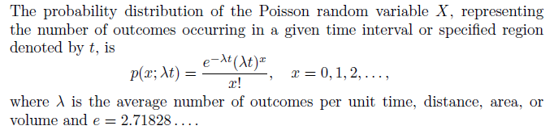

Poisson Distribution

Slide 15


Example: During a laboratory experiment, the average number of radioactive particles passing through a counter in 1 millisecond is 4. What is the probability that 6 particles enter the counter in a given millisecond?
Solution : Using the Poisson distribution with x = 6 and λt = 4

Slide 16

Example: Ten is the average number of oil tankers arriving each day at a certain port. The facilities at the port can handle at most 15 tankers per day. What is the probability that on a given day tankers have to be turned away?
Solution:

Slide 17
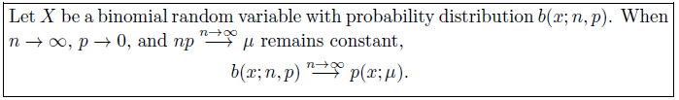
Approximation of Binomial Distribution by a Poisson Distribution

Slide 18


In a certain industrial facility, accidents occur infrequently. It is known that the probability of an accident on any given day is 0.005 and accidents are independent of each other.
(a) What is the probability that in any given period of 400 days there will be an accident on one day?
(b) What is the probability that there are at most three days with an accident?
Solution : Let X be a binomial random variable with n = 400 and p = 0.005. Thus, np = 2.Using the Poisson approximation,

Slide 19
Mean and variance

Slide 20
Assignment
5.53
5.56
5.57
5.58
5.61
5.64
5.65
5.69

